Slide 1
HUAWEI hackaton
solution

Slide 2
Baseline(L2): 0.74202
Distance/similarity function | Score(public)
Cosine | 0.84260
Bray-Curtis | 0.84208
Yule | 0.82652
Rogers-Tanimoto | 0.80167
Manhattan(L1) | 0.74106

Slide 3
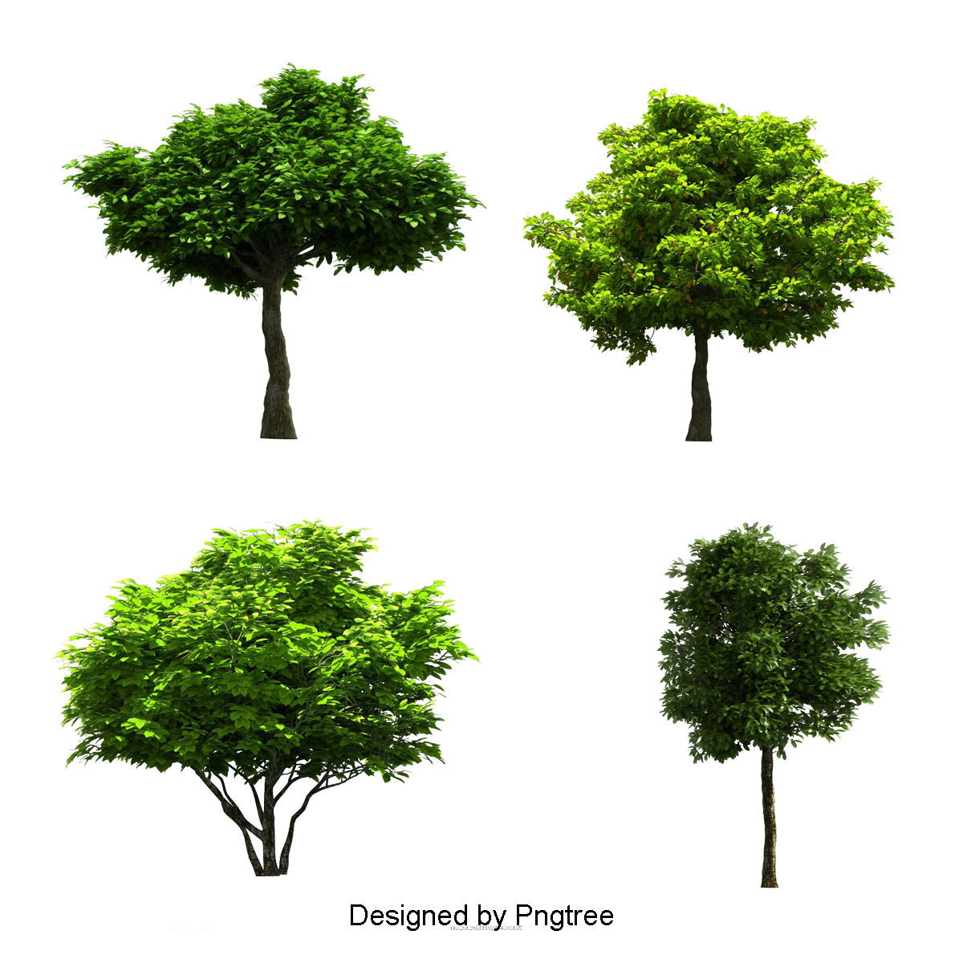
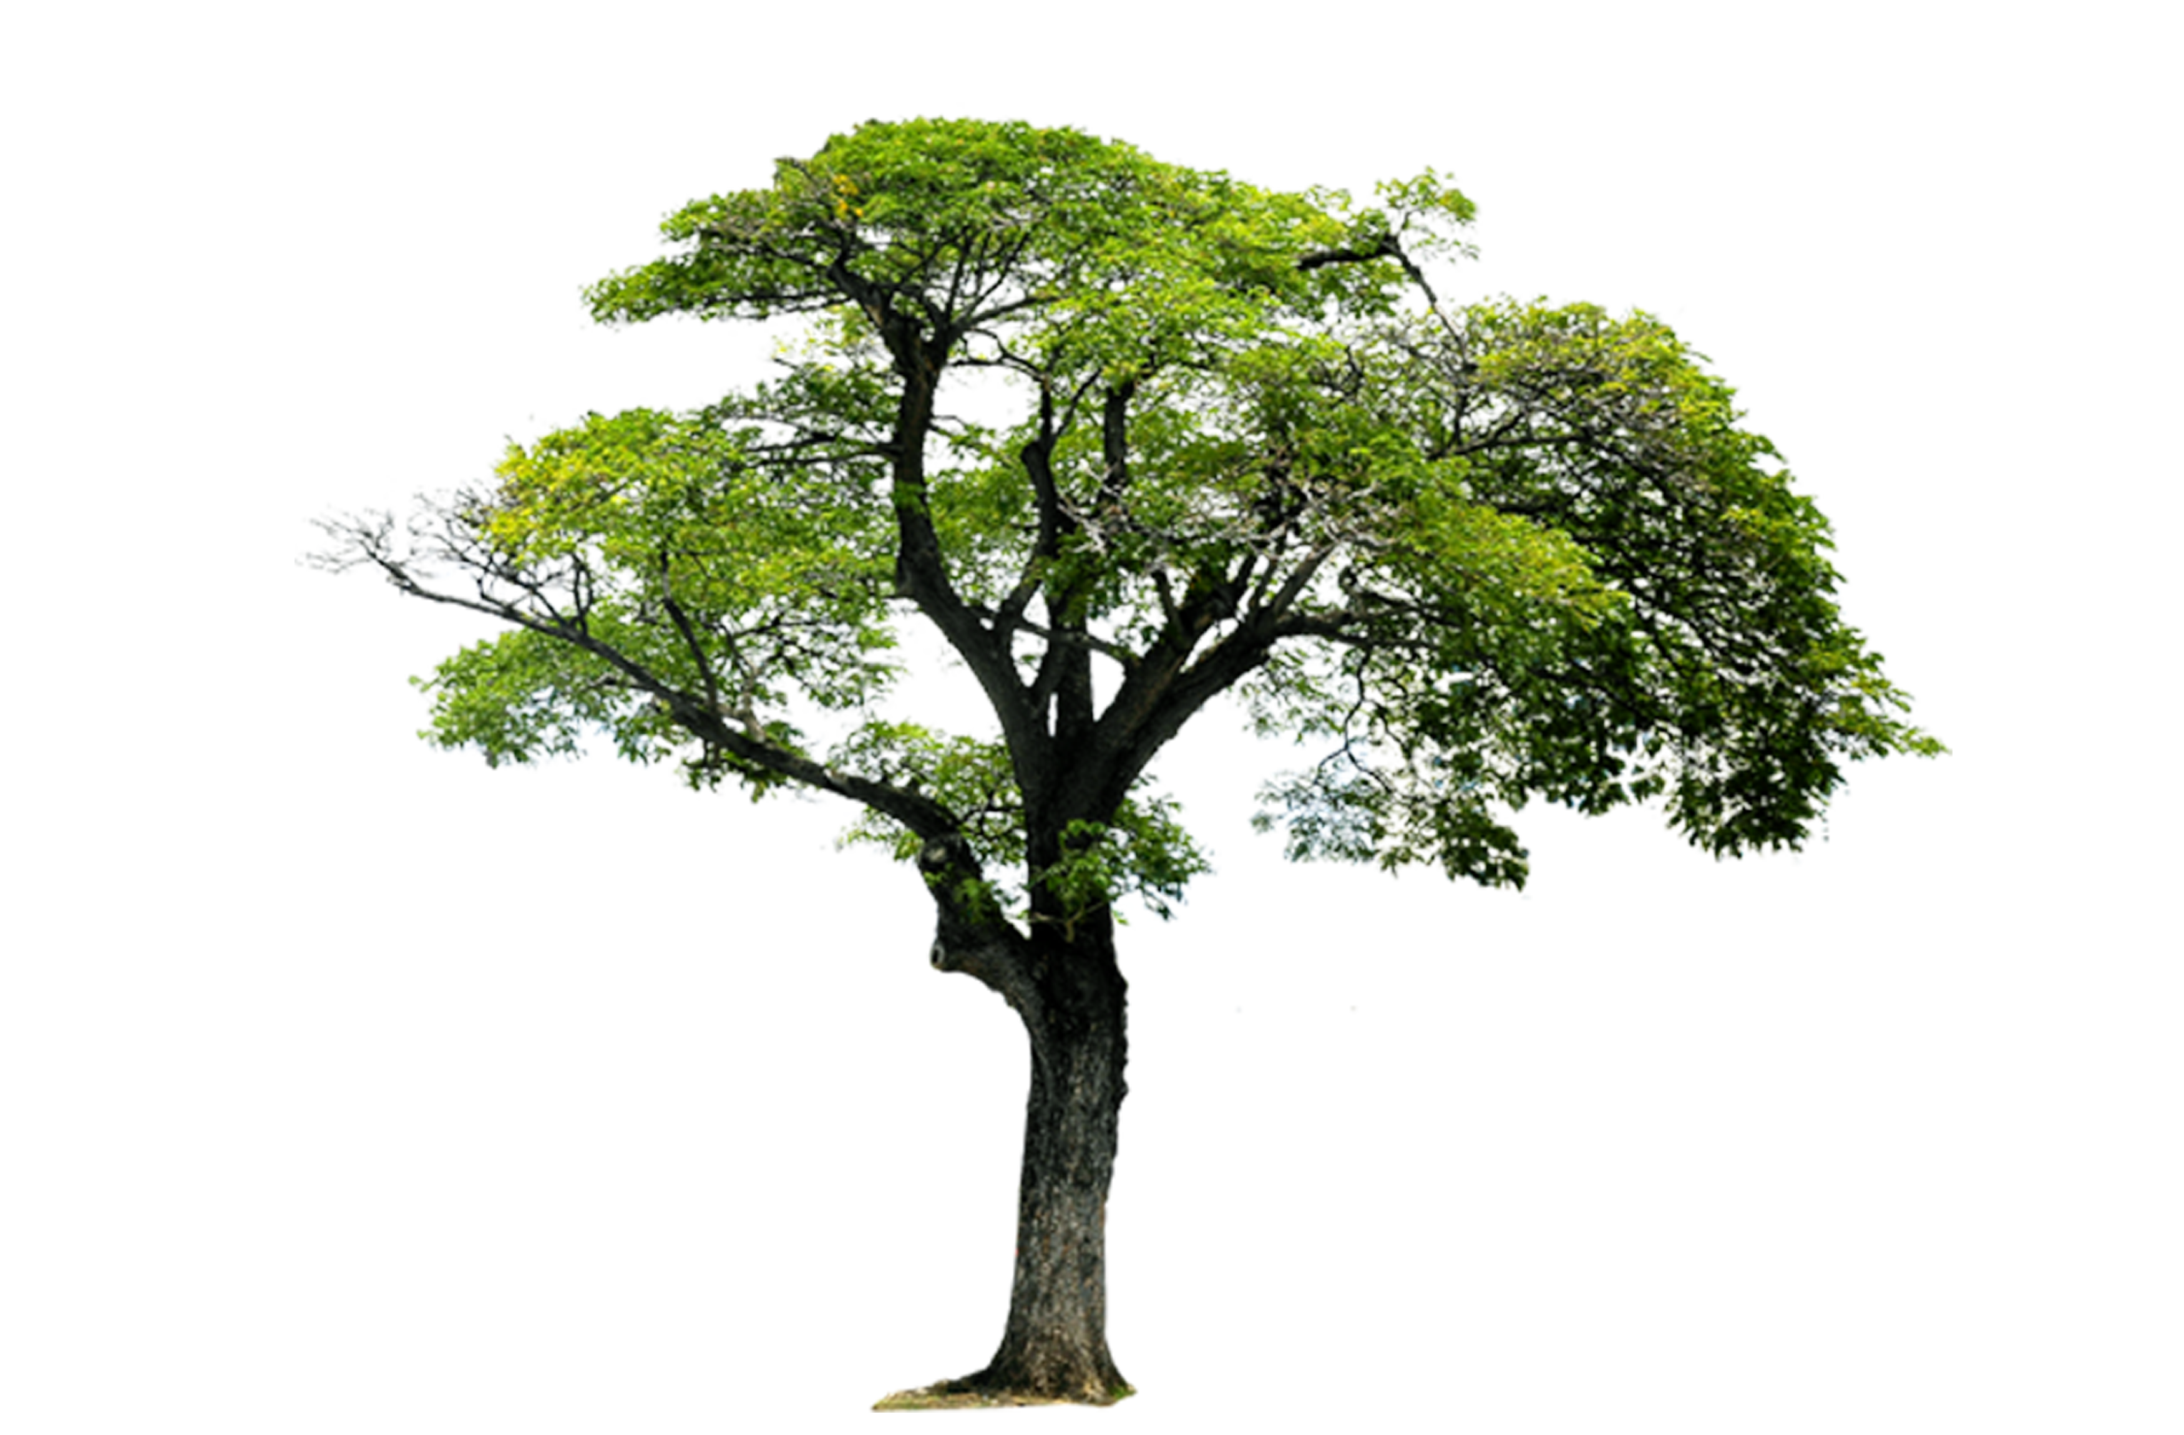
AN IDEA
Ensembles
Good
Better

Slide 4
Cosine: 0.84260
Function | Score(public)
Cosine * Bray-Curtis | 0.84249
Cosine * Bray-Curtis * Yule | 0.86398
Cosine * Bray-Curtis * Yule * Rogers-Tanimoto | 0.82040
(Cosine + Bray-Curtis) * (Yule + Rogers-Tanimoto) | 0.85739
Cosine * Bray-Curtis * Yule * abs(Rogers-Tanimoto) | 0.86940

